Slide 1


COVID-19 Group Presentation
Soona Brittney Cheon
Robert Freed
Jodi-Ann Osborne
Scott Rabinowitz
Notes:
we selected this topic, covid 19, is because it is undoubtebly a pressing issue for evertyone in the country and across the world. We want to provide insights into various metrics including but not limited to testing data, school data, population data, and health data,
We sourced our data from John’s Hopkins hospital data on covid-19, the cdc, and a few more well known sources for health data
As a group we set out to answer the following questions:
What is the correlation between cases and tests? What is the correlations between new cases and number of deaths? The relationship between # of vaccinations and Human Development Index. Also looking at how the Human Development Index affects total COVID cases. Find out how the Human Devlopment Index effects the vaccination rollout across different countries, and the relationship between days of school closures and cases in the country / region.
As we were exploring data and sorting through hundreds of databases, we came down to merging data from multiple sources in order to provide the insights and analysis we need.
As we dive into the project, technologies utilized are python technology, r studio, and tableau.

Slide 2
COVID-19 Group Presentation
Soona Brittney Cheon
Robert Freed
Jodi-Ann Osborne
Scott Rabinowitz

Slide 3

Agenda
Definition: Human Development Index (High >=.7)
Regression Analysis
Analyze HDI impact on Vaccination Rollout
Analyze HDI and the number of new COVID 19 cases
Machine Learning Model
COVID-19 impact
Conclusion
Notes:
Today, we will cover the following items throughout out presentation. First, we will define Human development index as a measure of development that assess and weigh factors such as health, longevity, level of education, and the standard of living for residents of that country. This measure ranges from 0 to 1 with most developed countries being close to 1. For our presentation, we will identify high Human development Index as greater than or equal to .7. Next, we will provide insight into our data using linear regression and correlation matrix to access factors such as HDI, vaccination rollout, the number of new cases, new deaths, total cases, and total new deaths. Next, we will present our finding using a machine learning model to access the relationship between school closure status and country. We will provide numerous visualizations showing COVID-19 impact on select countries and provide a closing summary. Our datset contains data from December 13, 2020 to February 24, 2021.

Slide 4

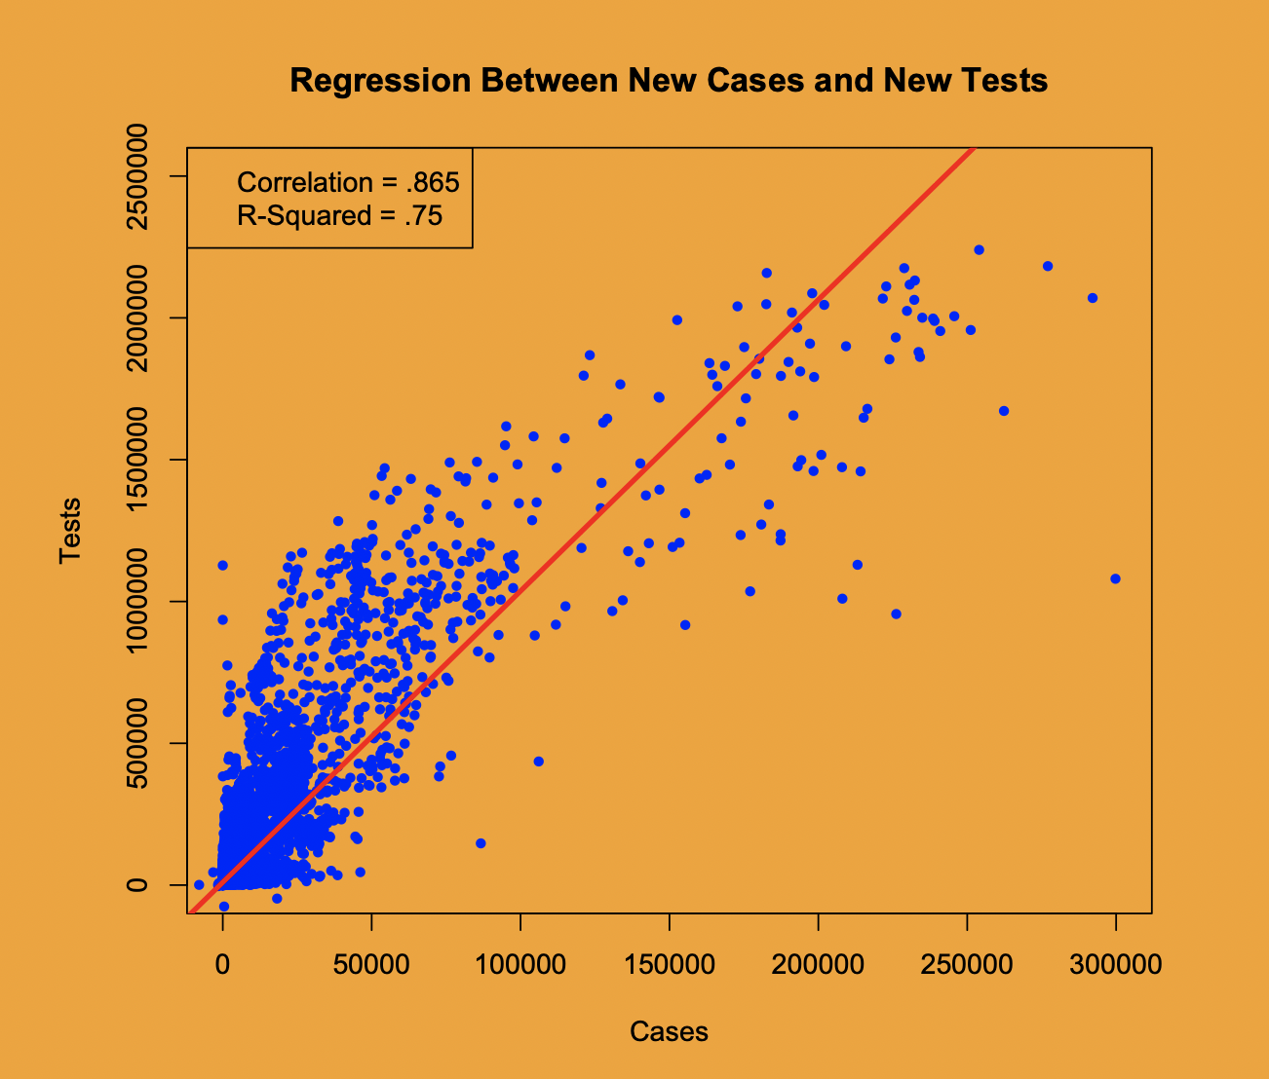
Regression analysis with R

Slide 5
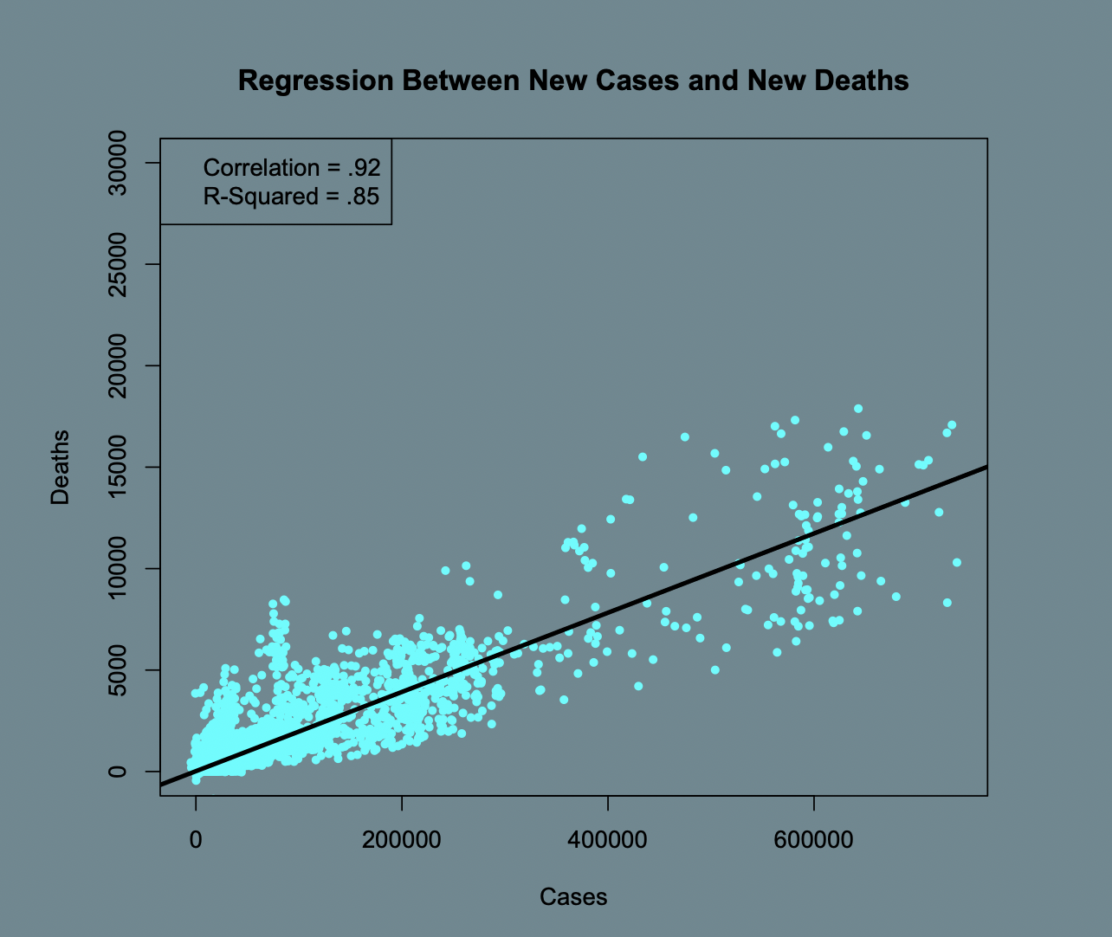
Regression analysis with R

Slide 6
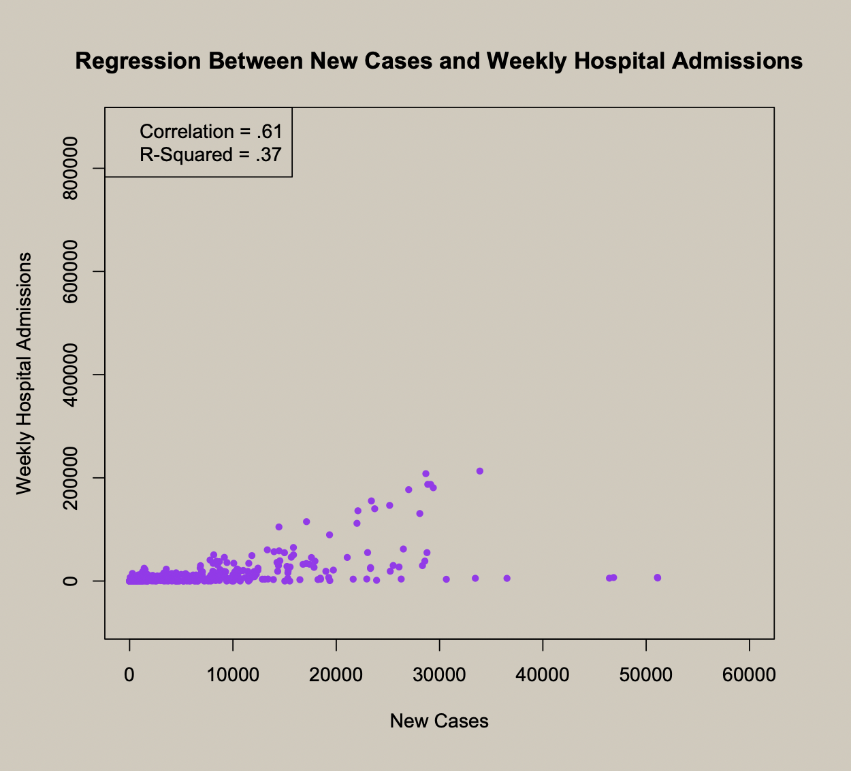
Regression analysis with R

Slide 7
Notes:
Next in the analysis, finding out the correlation between new cases and deaths. Here we can see that cases go up quite dramatically as deaths also do go up, but by a smaller margin. Relatively though, the increases are nearly linear on a percentage basis. Solving for the correlation, we get .92, showing a very strong relationship between new cases and new deaths. In addition the r-squared here is .85, meaning the proportional increase in deaths is 85% explained by new cases, leaving out little variability.

Slide 8
Notes:
A third and final regression analysis run in R studio is to see how hospital admissions and new cases are related. As we can see on the graph here, there is a moderate linear relationship with a correlation of .61, however, the r-squared is low at .37, meaning most of the variability in hospital admissions and cases is left to be explained. If the hospital data were more specific to only covid admissions and covid icu admissions, the metrics here would be stronger.

Slide 9
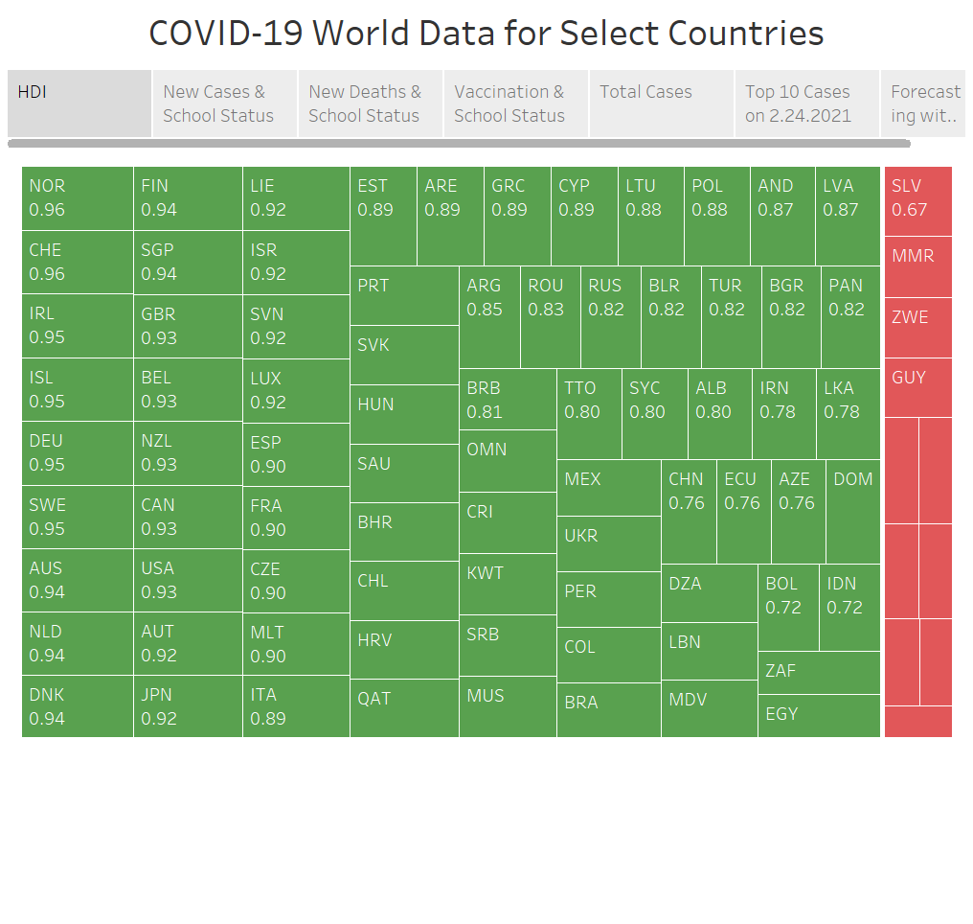
Notes:
The above illustration shows ISO codes and HDIs for the select countries. Countries in green have an HDI greater than to equal .7 while countries in red have an HDI less than .69.

Slide 10
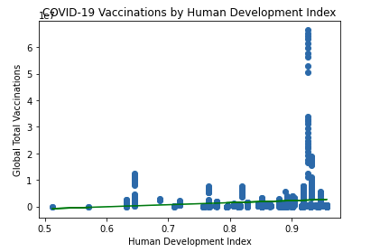
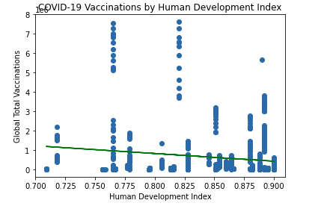
Analysis of Human Development Index and COVID-19 Vaccination Roll Out Thus Far

Slide 11
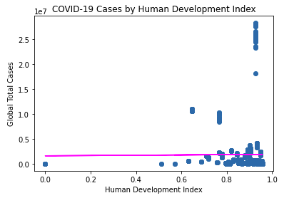
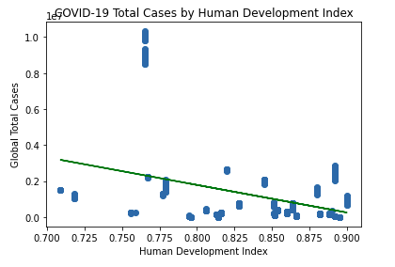
Analysis of Human Development Index and COVID-19 Cases Thus Far

Slide 12
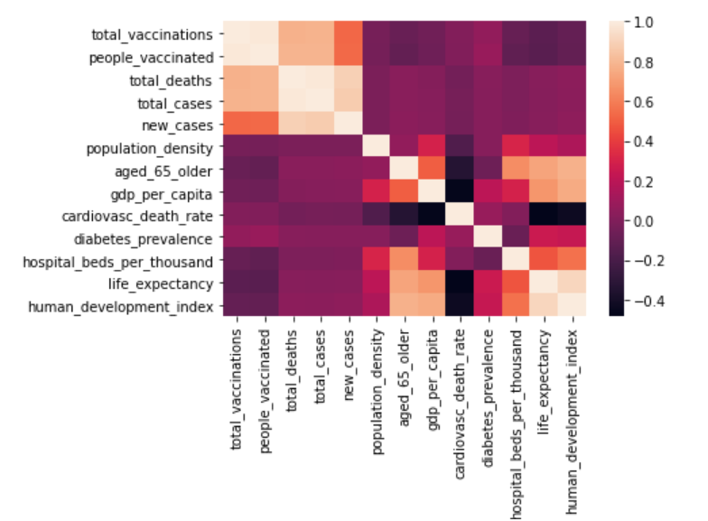
Correlation Matrix
Corrrelation Matrix Python

Slide 13
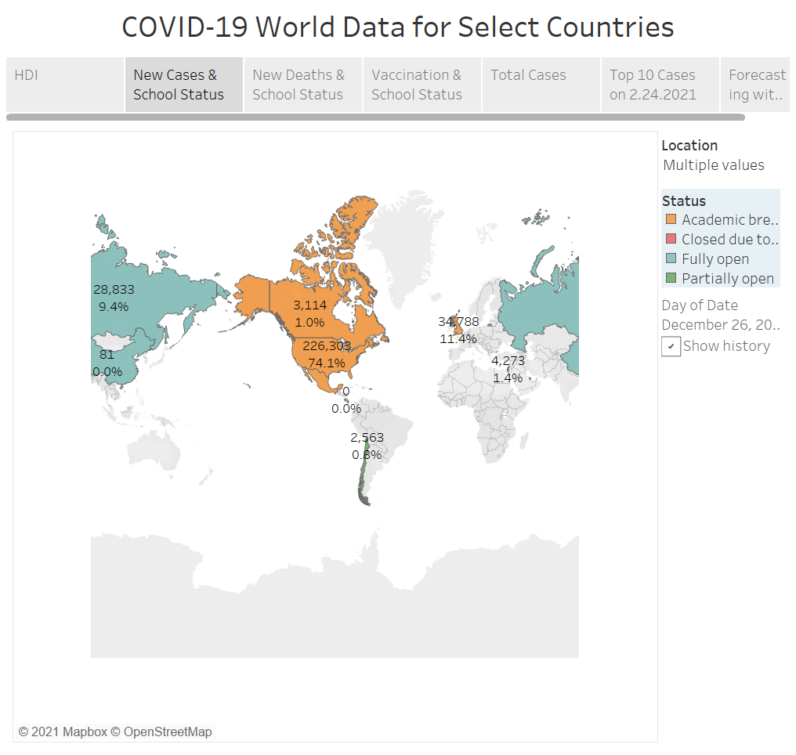

Slide 14
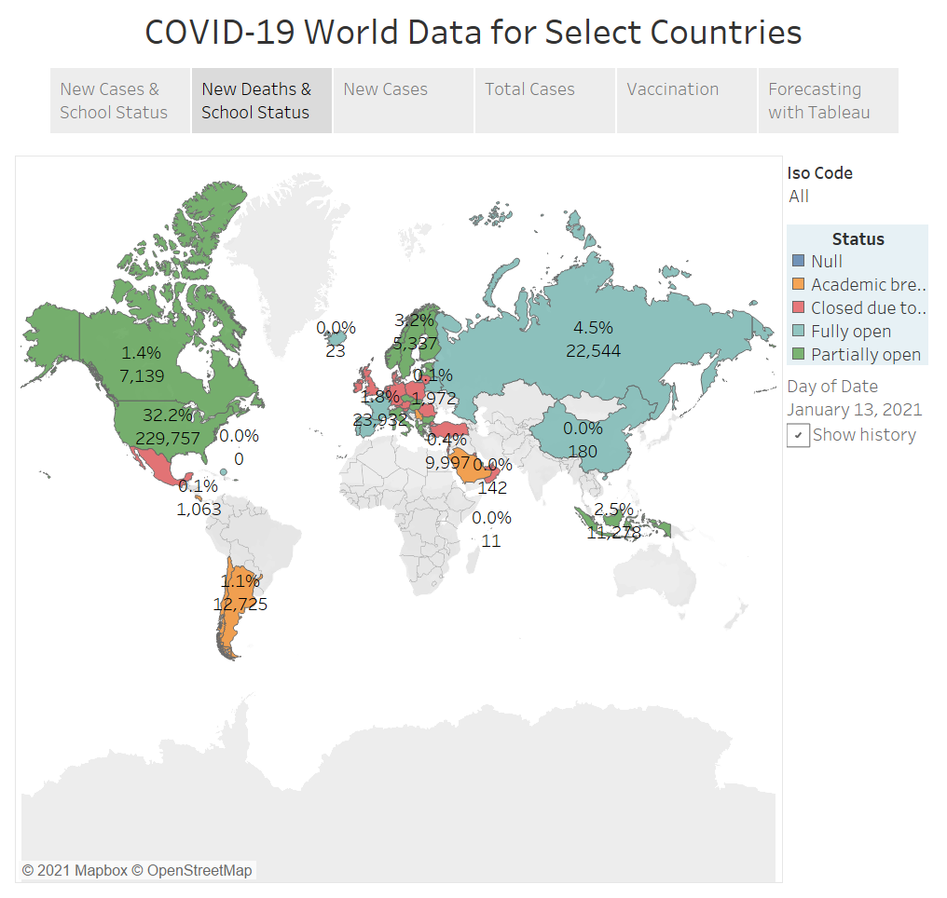
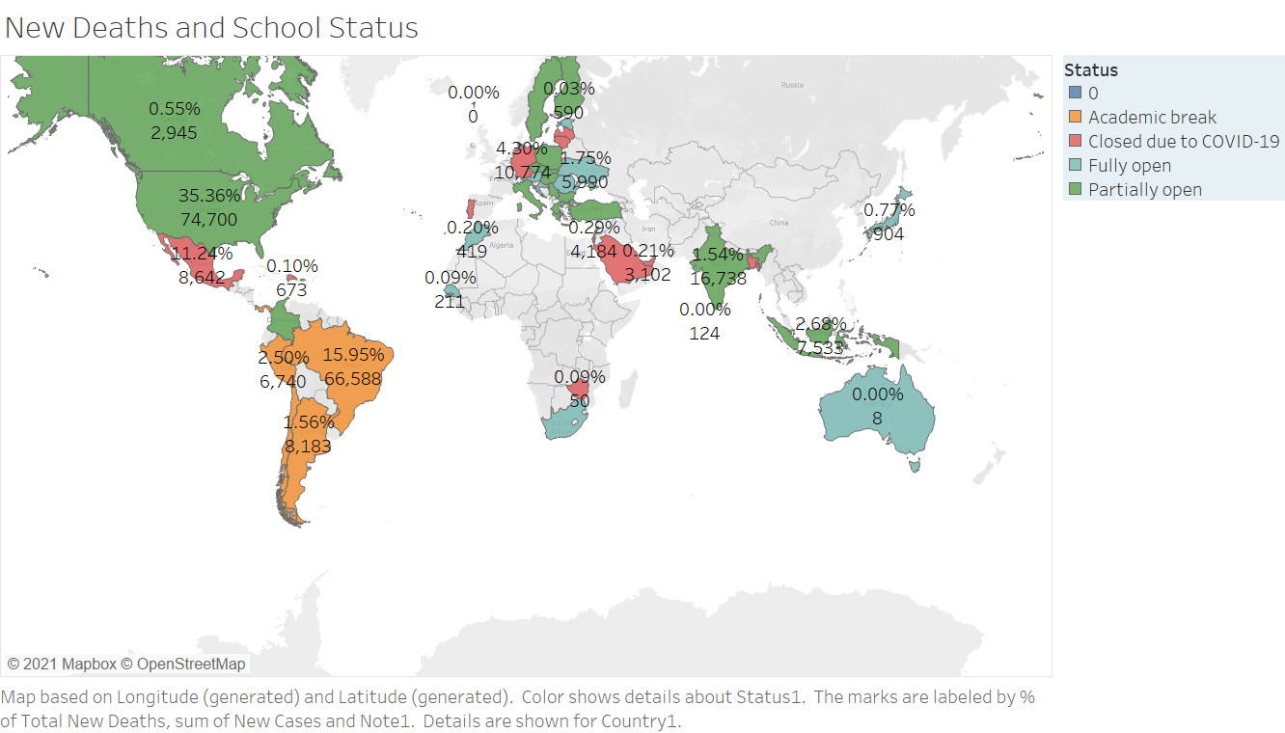

Slide 15
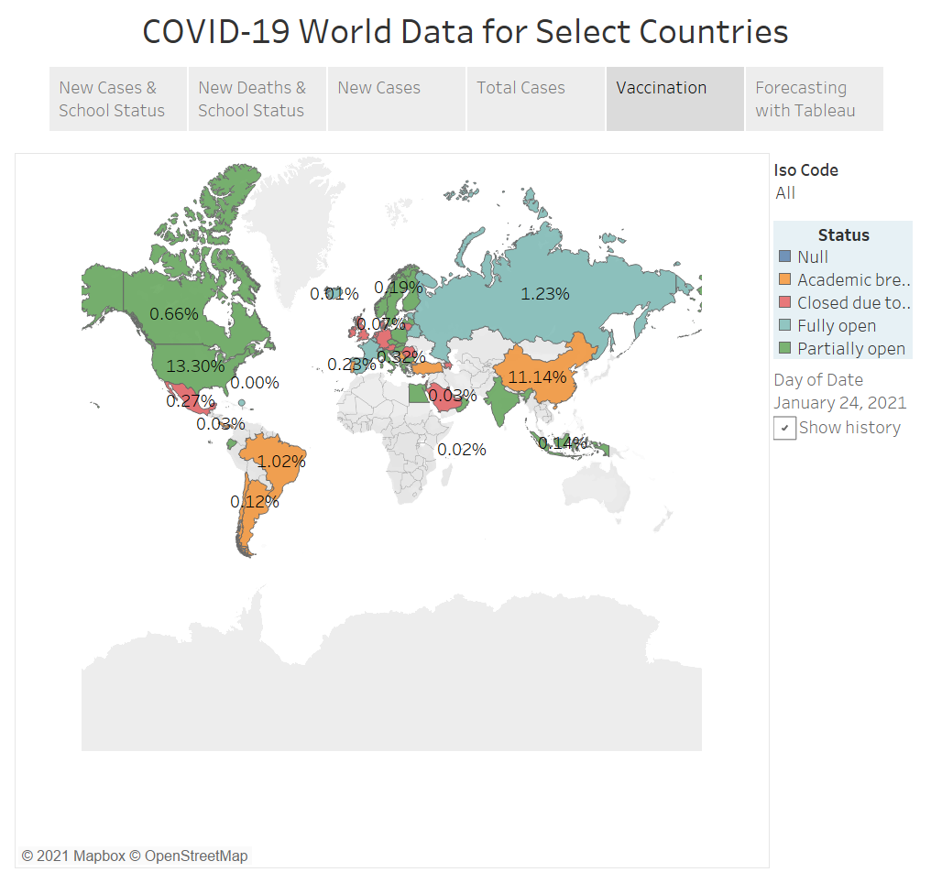
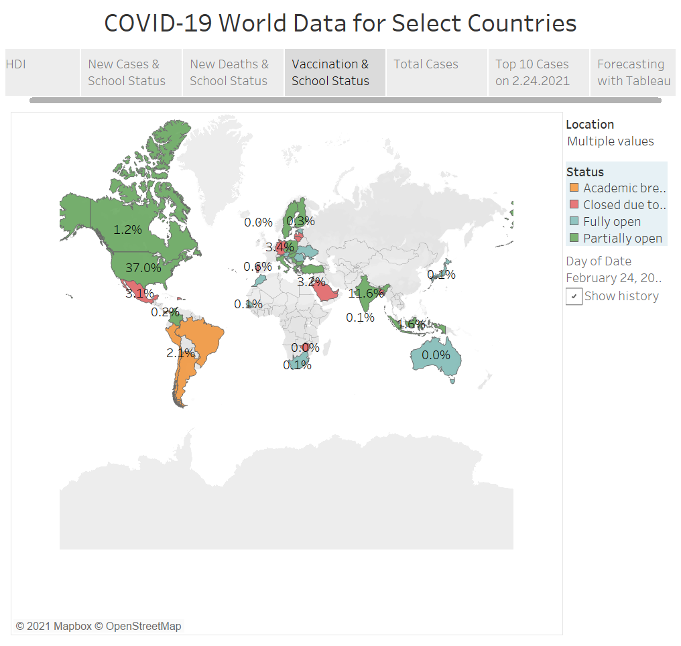

Slide 16
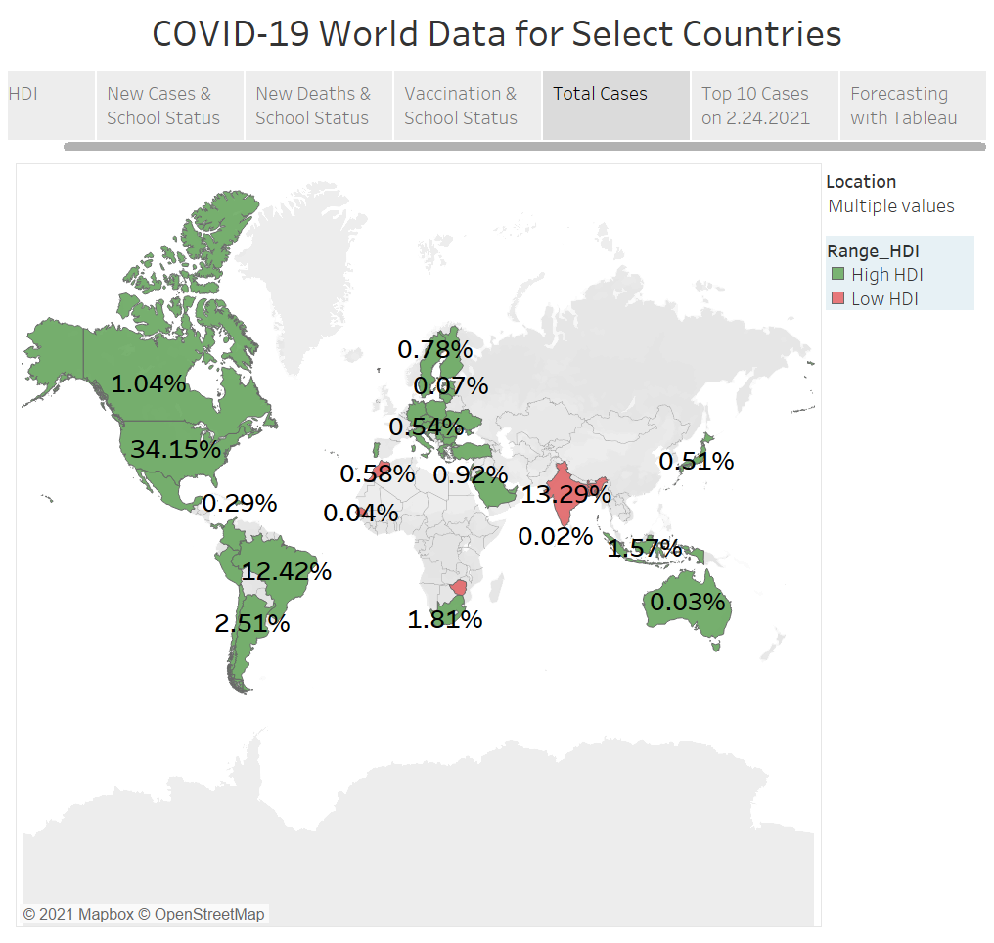

Slide 17
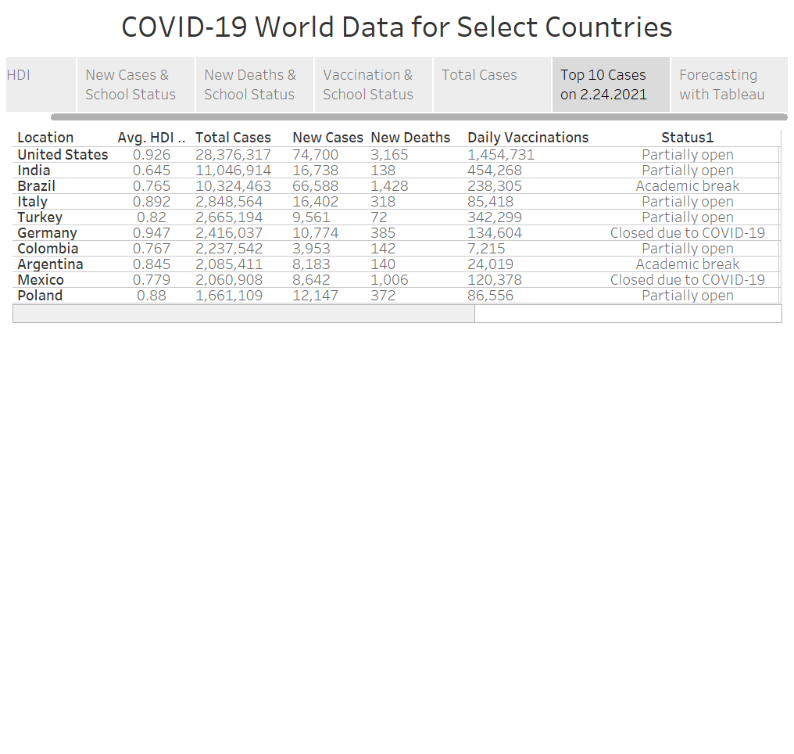

Slide 18
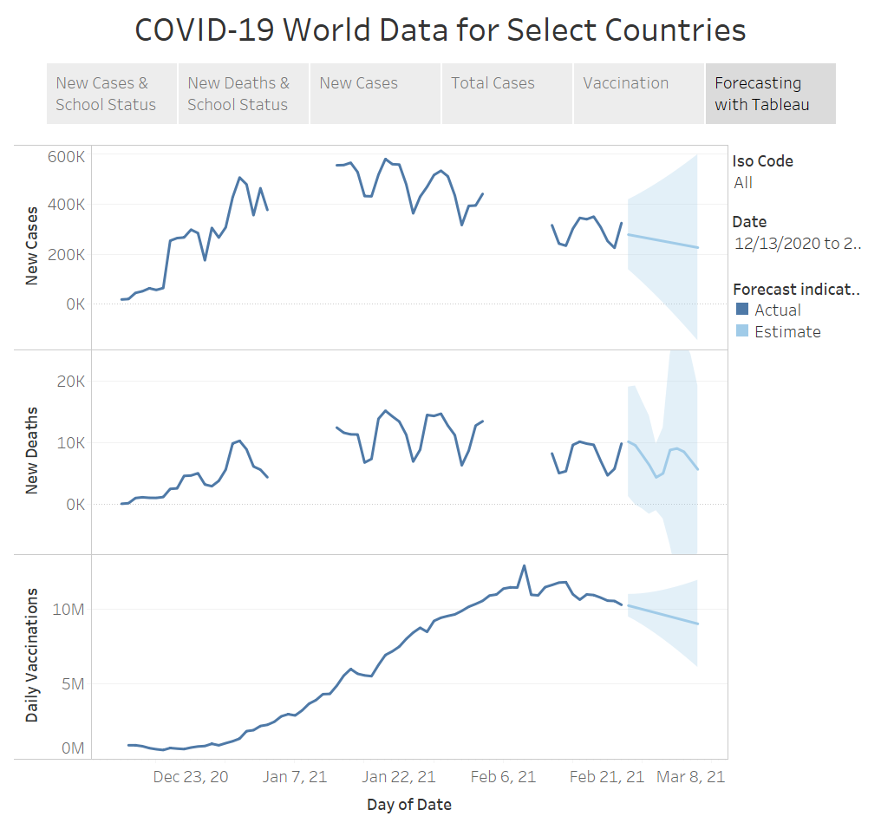

Slide 19
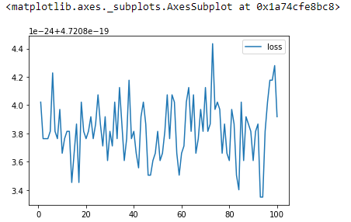
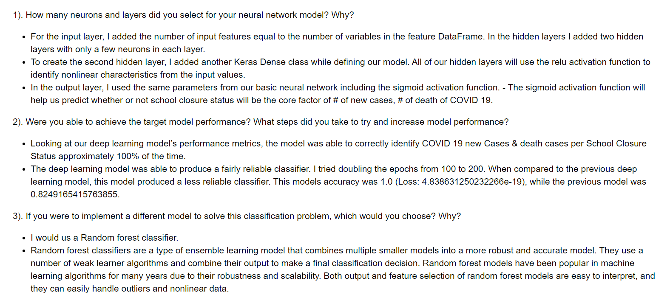
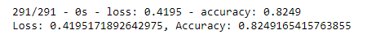
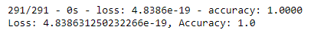
Machine Learning Summary

Slide 20
Take Awys: Driving Forces Behind Curbing COVID-19
HDI
Politics
Strains
Travel Restrictions
Availability of Testing and Vaccination

Slide 21

Questions???

